Slide 1
Distributed k-Means and k-Median Clustering on General Topologies Maria Florina Balcan, Steven Ehrlich, Yingyu Liangz
Presented by:
Aishwarya Anandan (aananda2)
Harshad Rai (hrrai2)
Rachneet Kaur (rk4)
Vipul Satone(vsatone2)

Slide 2
Introduction
Era of Big Data
Data distributed over multiple locations
Distributed databases
Images and videos over networks
Sensors
Centralized algorithms need to be scaled to distributed settings

Slide 3
Motivation
k-Means and k-Medians are center based clustering algorithms
Need a method to run k-means and k- medians on distributed data
Communication cost should be low
Run clustering algorithms on coreset

Slide 4
What is a coreset/ ϵ-coreset?
An ϵ-coreset is a weighted set of points whose cost on any set of centers is approximately the cost of the original data on those same centers up to accuracy ϵ.

Slide 5


Original data P with centers X

Slide 6
C = Cost( P , X )
Original data P with centers X

Slide 7




C = Cost( P , X )
P’ = ϵ-coreset
ϵ-coreset P’ with centers X

Slide 8
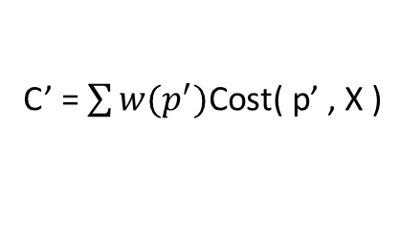
C = Cost( P , X )
P’ = ϵ-coreset
C’ = $\sum{w(p^{′})\text{Cost}\text{( }\text{p}\text{’ , }\text{X}\text{ )}}$
ϵ-coreset P’ with centers X

Slide 9
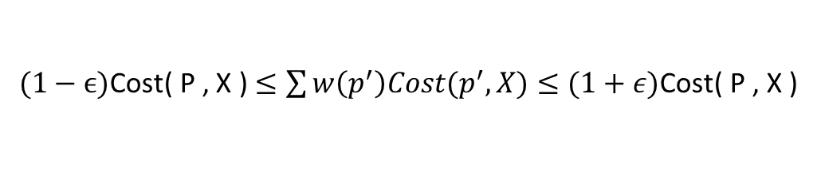
C = Cost( P , X )
P’ = ϵ-coreset
C’ = $\sum{w(p^{′})\text{Cost}\text{( }\text{p}\text{’ , }\text{X}\text{ )}}$
$(1−\text{ϵ}\text{)}\text{Cost}\text{( }\text{P}\text{ , }\text{X}\text{ )}≤\sum{w\left(p^{′}\right)Cost(p^{′},X)≤(1+ε)\text{Cost}\text{( }\text{P}\text{ , }\text{X}\text{ )}}$
ϵ-coreset P’ with centers X

Slide 10
What is a coreset/ ϵ-coreset?
An ϵ-coreset is a weighted set of points whose cost on any set of centers is approximately the cost of the original data on those same centers up to accuracy ϵ.
Thus an approximate solution for the coreset is also an approximate solution for the original data.

Slide 11
How are coresets constructed?

Slide 12
Original data P

Slide 13
1) Compute constant approximate solution
Original data P with centers X

Slide 14
1) Compute constant approximate solution
2) Calculate cost of solution
Original data P with centers X

Slide 15
1) Compute constant approximate solution
2) Calculate cost of solution
3) Sample points with
probability proportional to their contributions to the cost.
Coreset P’ with centers X

Slide 16
Methodology
The dataset is distributed on several nodes in an undirected connected graph.
A local constant approximation solution is computed
The total cost of local solution communicated to the other nodes in the graph using a message passing algorithm.
Based on the cost of nodes and the contribution of the data towards their local solution, the local data are sampled to form local coresets

Slide 17

v6
v4
v3
v5
v2
v1

Slide 18
v6
P4
v4
P6
v3
v5
P3
P5
v2
P2
v1
P1

Slide 19
Methodology
The dataset is distributed on several nodes in an undirected connected graph.
A local constant approximation solution is computed
The total cost of local solution communicated to the other nodes in the graph using a message passing algorithm.
Based on the cost of nodes and the contribution of the data towards their local solution, the local data are sampled to form local coresets

Slide 20
v6
P4, X4
v4
P6, X6
v3
v5
P3, X3
P5, X5
v2
P2, X2
v1
P1, X1

Slide 21
Methodology
The dataset is distributed on several nodes in an undirected connected graph.
A local constant approximation solution is computed
The total cost of local solution communicated to the other nodes in the graph using a message passing algorithm.
Based on the cost of nodes and the contribution of the data towards their local solution, the local data are sampled to form local coresets

Slide 22
v6
Local Costs
v4
Local Costs
Local Costs
v3
v5
Local Costs
v2
Local Costs
Local Costs
v1

Slide 23
Methodology
The dataset is distributed on several nodes in an undirected connected graph.
A local constant approximation solution is computed
The total cost of local solution communicated to the other nodes in the graph using a message passing algorithm.
Based on the cost of nodes and the contribution of the data towards their local solution, the local data are sampled to form local coresets

Slide 24
v6
S4
v4
S6
v3
v5
S3
S5
v2
S2
v1
S1

Slide 25
The message passing algorithm is called once again to combine the local coresets.
If each node constructs an ϵ-coreset on its local data, then the union of these local coresets is an ϵ-coreset for the entire data.
The constant approximation algorithm is applied to this global coreset to obtain the final result.

Slide 26
v6
Local Coresets
v4
Local Coresets
Local Coresets
v3
v5
Local Coresets
v2
Local Coresets
Local Coresets
v1

Slide 27
The message passing algorithm is called once again to combine the local coresets.
If each node constructs an ϵ-coreset on its local data, then the union of these local coresets is an ϵ-coreset for the entire data.
The constant approximation algorithm is applied to this global coreset to obtain the final result.

Slide 28
The message passing algorithm is called once again to combine the local coresets.
If each node constructs an ϵ-coreset on its local data, then the union of these local coresets is an ϵ-coreset for the entire data.
The constant approximation algorithm is applied to this global coreset to obtain the final result.

Slide 29
Comparison to Other Coreset Algorithms:
Zhang et. al.[1] is limited to rooted trees.
The communication cost to develop coresets is very high.
Although it is possible to find a spanning tree, when the graph has large diameter every tree has large height which greatly increases the size of coresets which must be communicated across the lower levels of the tree.
D. Feldman et. al.[2] ignores the communication cost and merges coresets in a parallel computation model.
Notes:
Each node constructs a local coreset and passes it to its parent node.
The parent node then combines the incoming coresets and constructs a coreset on the combination of its child coresets.
This process continues until the root of the tree is reached.

Slide 30


Slide 31
Comparison to Other Coreset Algorithms:
Zhang et. al.[1] is limited to rooted trees.
The communication cost to develop coresets is very high.
Although it is possible to find a spanning tree, when the graph has large diameter every tree has large height which greatly increases the size of coresets which must be communicated across the lower levels of the tree.
D. Feldman et. al.[2] ignores the communication cost and merges coresets in a parallel computation model.
Notes:
Each node constructs a local coreset and passes it to its parent node.
The parent node then combines the incoming coresets and constructs a coreset on the combination of its child coresets.
This process continues until the root of the tree is reached.

Slide 32
Technical Background

Slide 33
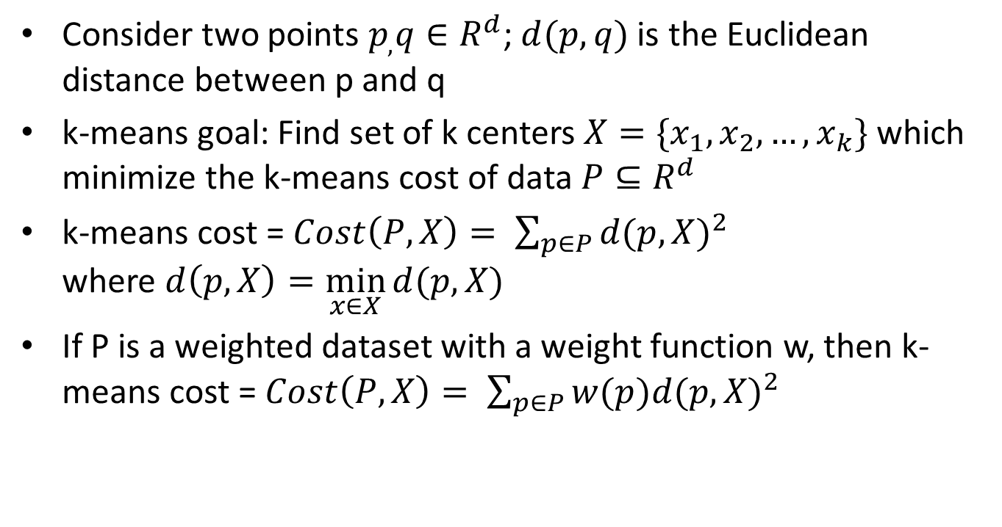
Preliminaries
Consider two points $p_{,}q∈R^{d}$; $d(p,q)$ is the Euclidean distance between p and q
k-means goal: Find set of k centers $X=\{x_{1},x_{2}, …,x_{k}\}$ which minimize the k-means cost of data $P⊆R^{d}$
k-means cost = $Cost\left(P,X\right)= \sum_{p∈P}{{d(p,X)}^{2}}$ where $d\left(p,X\right)=\min_{x∈X}{d(p,X)}$
If P is a weighted dataset with a weight function w, then k-means cost = $Cost\left(P,X\right)= \sum_{p∈P}{w(p){d(p,X)}^{2}}$

Slide 34
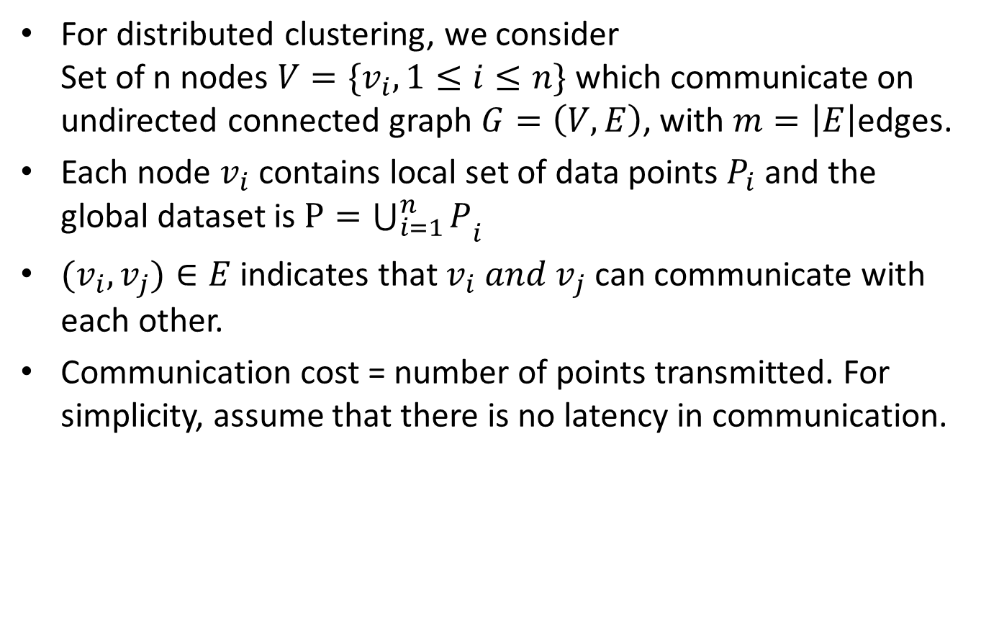
For distributed clustering, we consider Set of n nodes $V=\{v_{i}, 1≤i≤n\}$ which communicate on undirected connected graph $G=\left(V,E\right)$, with $m=\left|E\right|$edges.
Each node $v_{i}$contains local set of data points $P_{i}$ and the global dataset is $P={\bigcup_{i=1}^{n}{P}}_{i}$
$(v_{i},v_{j})∈E$ indicates that ${v_{i} and v}_{j}$ can communicate with each other.
Communication cost = number of points transmitted. For simplicity, assume that there is no latency in communication.

Slide 35
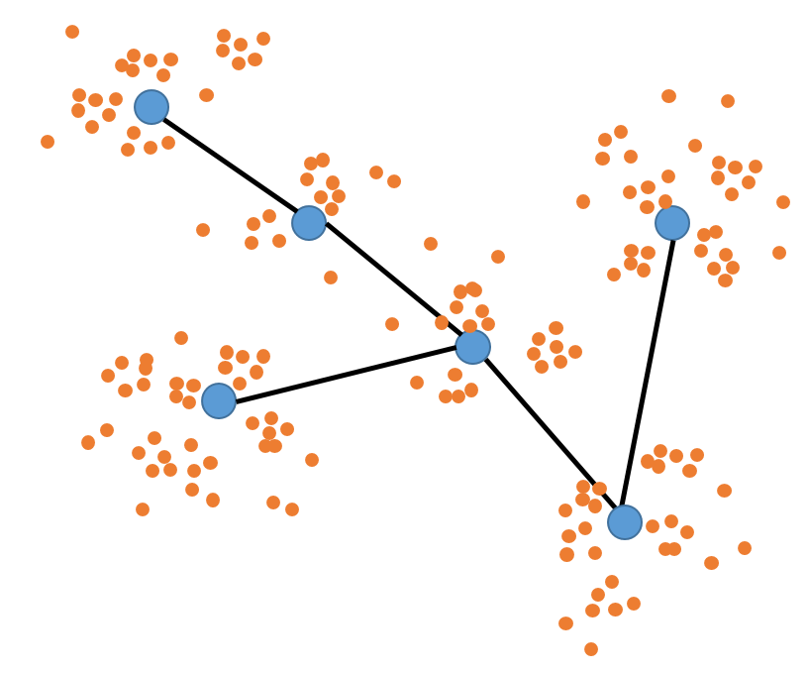
Distributed coreset construction
Compute centers for local data
Compute constant approximation
Communicate costs to nodes
Compute number of points to be sampled
Set weights on local data
Random Sampling of points to coreset
Inclusion of local centers to coreset
Round 1
Round 2
Input: Data (distributed across different nodes)
P_{i} : Set of points in node i
Round 1 is performed on each node followed by Round 2.
Only cost values are communicated.

Slide 36
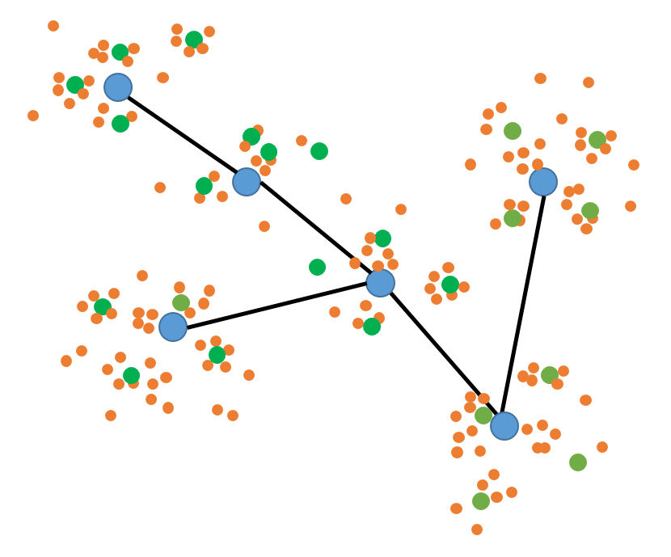
Round 1
Compute centers for local data
Compute constant approximation
Communicate costs to nodes
Compute number of points to be sampled
Set weights on local data
Random Sampling of points to coreset
Inclusion of local centers to coreset
Round 1
Round 2
Step 1: Computing centers for local data
Perform k-center clustering on node data (Lloyd’s Algorithm)
Output: Set of centers B_{i} for P_{i}

Slide 37
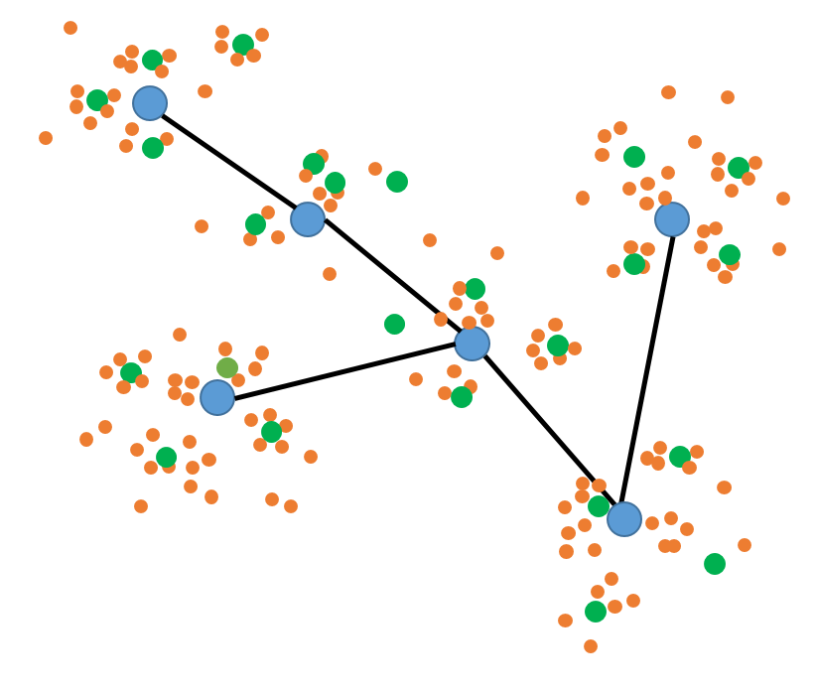
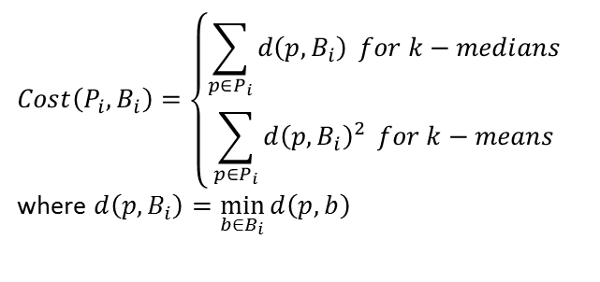
Round 1
Compute centers for local data
Compute constant approximation
Communicate costs to nodes
Compute number of points to be sampled
Set weights on local data
Random Sampling of points to coreset
Inclusion of local centers to coreset
Round 1
Round 2
Step 2: Computing constant approximation
$$Cost\left(P_{i},B_{i}\right)=\left\{\begin{aligned}\sum_{p∈P_{i}}{d\left(p,B_{i}\right)} for k−medians \\ &\sum_{p∈P_{i}}{{d\left(p,B_{i}\right)}^{2}} for k−means\end{aligned}\right.$$
where $d\left(p,B_{i}\right)=\min_{b∈B_{i}}{d\left(p,b\right)}$

Slide 38
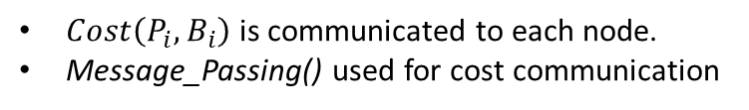
Round 1
Compute centers for local data
Compute constant approximation
Communicate costs to nodes
Compute number of points to be sampled
Set weights on local data
Random Sampling of points to coreset
Inclusion of local centers to coreset
Round 1
Round 2
Step 3: Communicating cost to nodes
$Cost\left(P_{i},B_{i}\right)$ is communicated to each node.
Message_Passing() used for cost communication

Slide 39
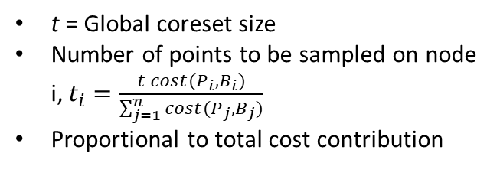
Round 2
Compute centers for local data
Compute constant approximation
Communicate costs to nodes
Compute number of points to be sampled
Set weights on local data
Random Sampling of points to coreset
Inclusion of local centers to coreset
Round 1
Round 2
Step 1: Computing # of points to be sampled
t = Global coreset size
Number of points to be sampled on node i, $t_{i}$ $=\frac{t cost(P_{i},B_{i})}{\sum_{j=1}^{n}{cost(P_{j},B_{j})}}$
Proportional to total cost contribution

Slide 40
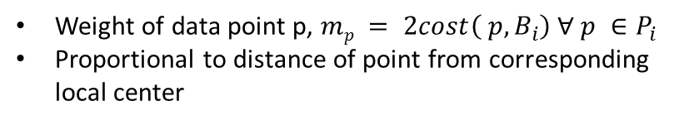
Round 2
Compute centers for local data
Compute constant approximation
Communicate costs to nodes
Compute number of points to be sampled
Set weights on local data
Random Sampling of points to coreset
Inclusion of local centers to coreset
Round 1
Round 2
Step 2: Setting of weights on local data
Weight of data point p, $mp = 2cost\left( p,B_{i}\right) ∀ p ∈P_{i}$
Proportional to distance of point from corresponding local center

Slide 41
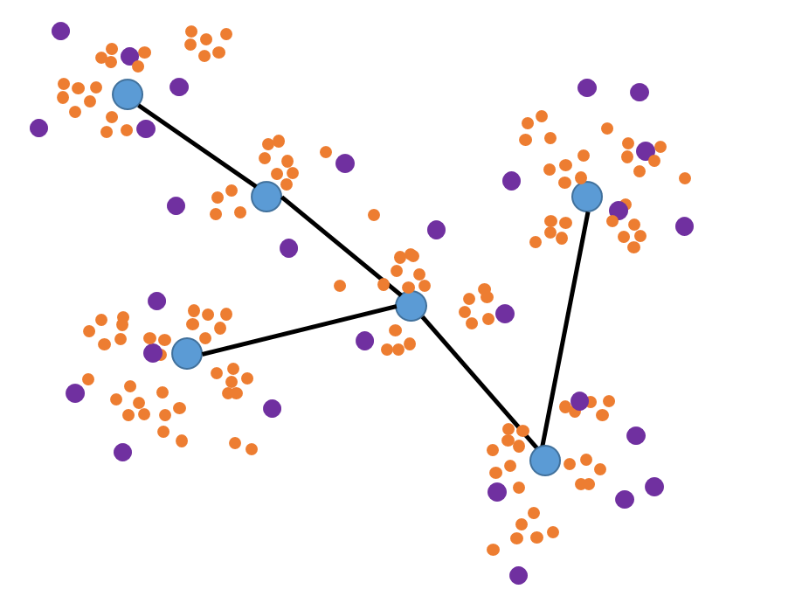
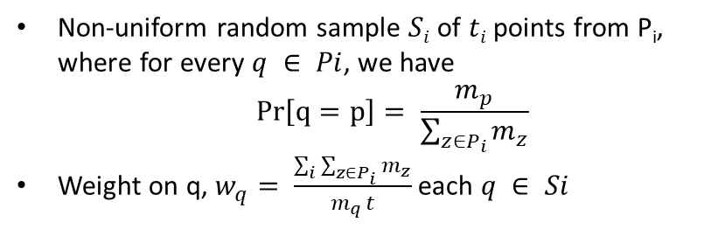
Round 2
Compute centers for local data
Compute constant approximation
Communicate costs to nodes
Compute number of points to be sampled
Set weights on local data
Random Sampling of points to coreset
Inclusion of local centers to coreset
Round 1
Round 2
Step 3: Random sampling of points to coreset
Non-uniform random sample $Si$ of $ti$ points from P_{i}, where for every $q ∈ Pi$, we have
$$Pr\left[q=p\right]= \frac{m_{p}}{\sum_{z∈P_{i}}{m_{z}}}$$
Weight on q, $w_{q}= \frac{\sum_{i}{\sum_{z∈P_{i}}{m_{z}}}}{m_{q }t}$each $q ∈ Si$

Slide 42
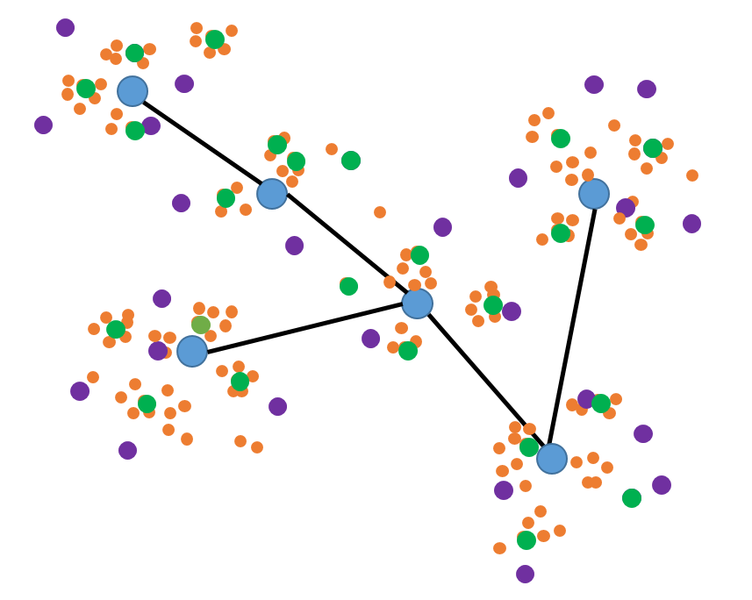
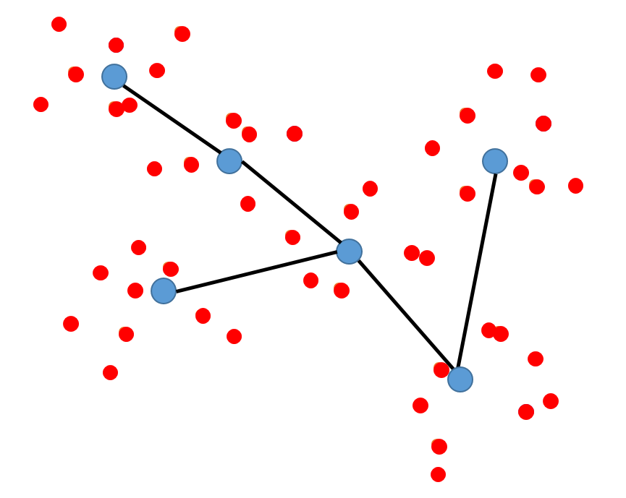
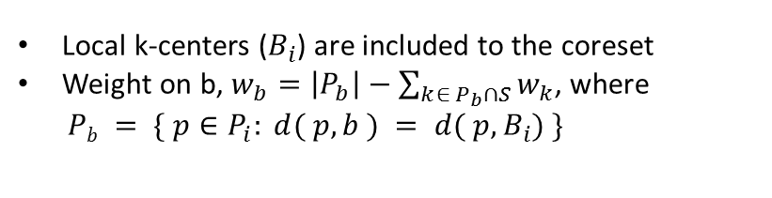
Round 2
Compute centers for local data
Compute constant approximation
Communicate costs to nodes
Compute number of points to be sampled
Set weights on local data
Random Sampling of points to coreset
Inclusion of local centers to coreset
Round 1
Round 2
Step 4: Including local centers to coreset
Local k-centers ($B_{i}$) are included to the coreset
Weight on b, $w_{b}=\left|P_{b}\right|−\sum_{k∈ P_{b}∩S}{w_{k}}$, where
$Pb = \{ p∈P_{i}: d( p, b ) = d( p,B_{i}) \}$

Slide 43
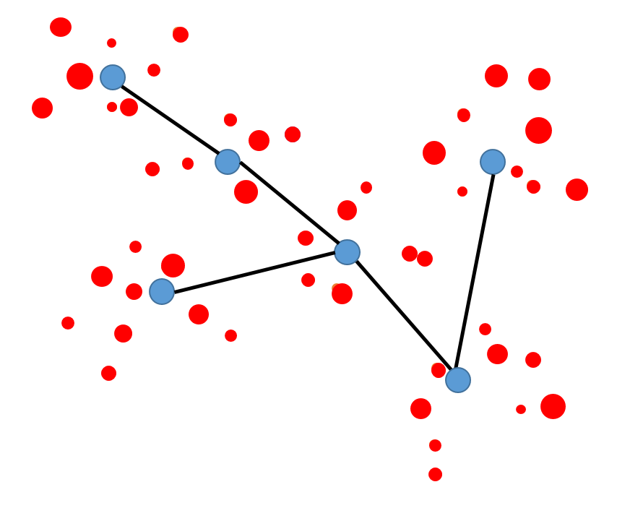
Distributed coreset construction
Compute centers for local data
Compute constant approximation
Communicate costs to nodes
Compute number of points to be sampled
Set weights on local data
Random Sampling of points to coreset
Inclusion of local centers to coreset
Round 1
Round 2
Input: Data (distributed across different nodes)
Output: Weighted Coreset

Slide 44
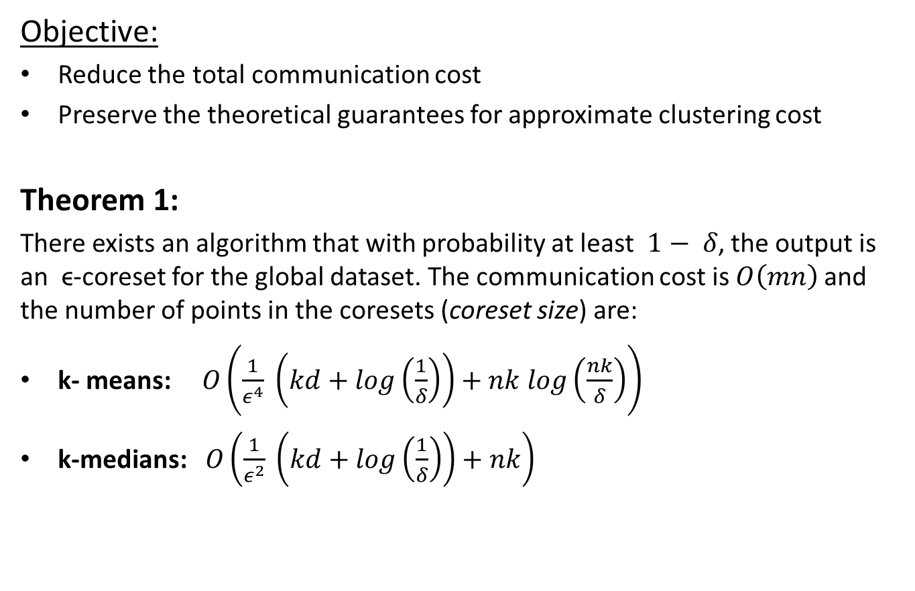
Objective:
Reduce the total communication cost
Preserve the theoretical guarantees for approximate clustering cost
Theorem 1:
There exists an algorithm that with probability at least $1− δ$, the output is an ϵ-coreset for the global dataset. The communication cost is $O\left(mn\right)$and the number of points in the coresets (coreset size) are:
k- means: $O\left(\frac{1}{ε^{4}} \left(kd+log\left(\frac{1}{δ}\right)\right)+nk log\left(\frac{nk}{δ}\right)\right)$
k-medians: $O\left(\frac{1}{ε^{2}} \left(kd+log\left(\frac{1}{δ}\right)\right)+nk\right)$

Slide 45
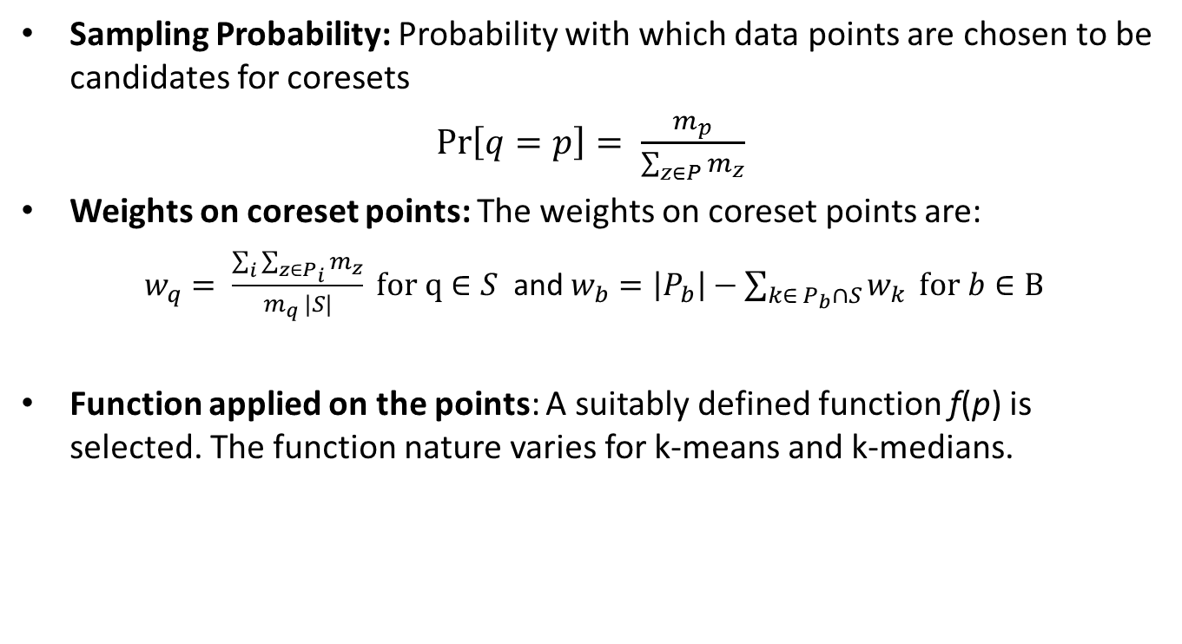
Key Parameters
Sampling Probability: Probability with which data points are chosen to be candidates for coresets
$\operatorname{Pr}\left[q=p\right]= \frac{m_{p}}{\sum_{z∈P}{m_{z}}}$
Weights on coreset points: The weights on coreset points are:
$w_{q}= \frac{\sum_{i}{\sum_{z∈P_{i}}{m_{z}}}}{m_{q }|S|} for q∈S$ and $w_{b}=\left|P_{b}\right|−\sum_{k∈ P_{b}∩S}{w_{k}} for b∈B$
Function applied on the points: A suitably defined function f(p) is selected. The function nature varies for k-means and k-medians.

Slide 46
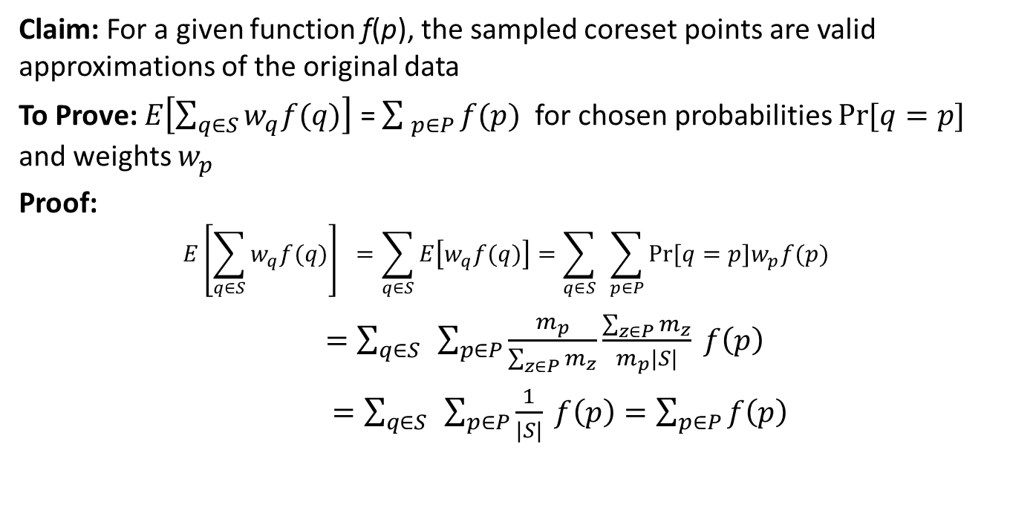
Validity of Sampling probability and Weights
Claim: For a given function f(p), the sampled coreset points are valid approximations of the original data
To Prove: $E\left[\sum_{q∈S}{w_{q}f(q)}\right]$ = $\sum_{ p∈P}{f(p)}$ for chosen probabilities $Pr⁡[q=p]$ and weights $w_{p}$
Proof:
$$E\left[\sum_{q∈S}{w_{q}f(q)}\right] =\sum_{q∈S}{E\left[w_{q}f(q)\right]=\sum_{q∈S}{ }\sum_{p∈P}{Pr⁡[q=p]w_{p}f(p) }}$$
$=\sum_{q∈S}{ }\sum_{p∈P}{\frac{m_{p}}{\sum_{z∈P}{m_{z}}}\frac{\sum_{z∈P}{m_{z}}}{m_{p}|S|}} f\left(p\right)$
$=\sum_{q∈S}{ }\sum_{p∈P}{\frac{1}{|S|}} f\left(p\right)=\sum_{p∈P}{f\left(p\right)}$

Slide 47
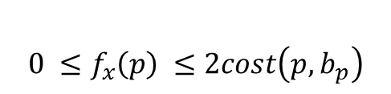
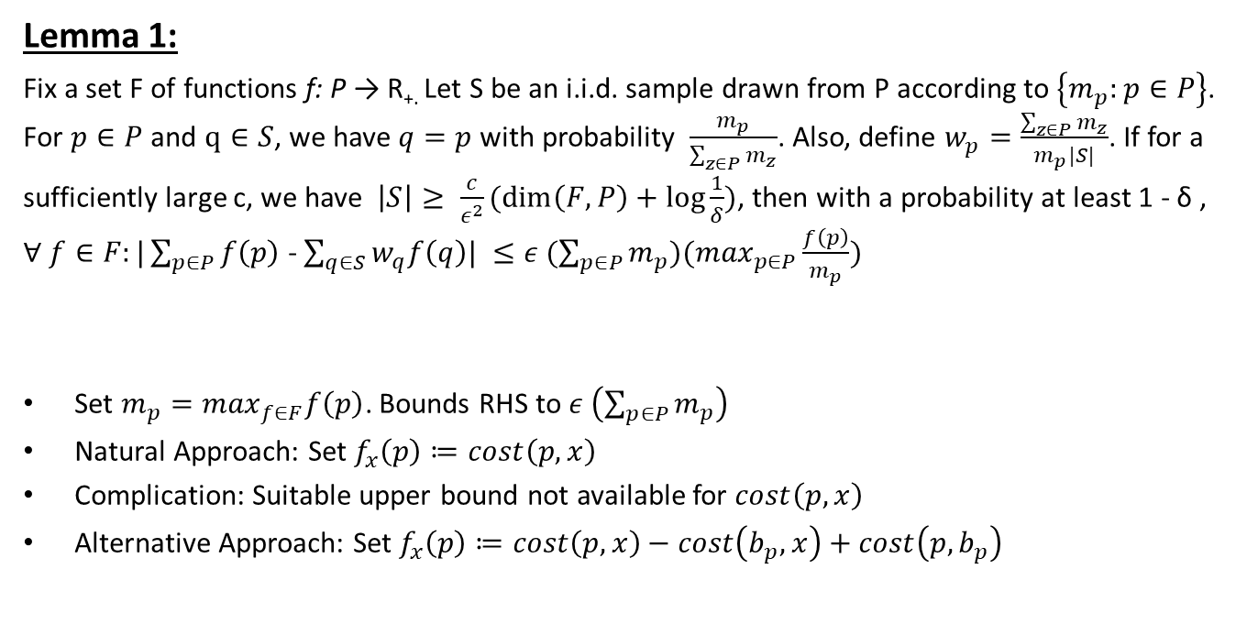
Validity of f(p)
Lemma 1:
Fix a set F of functions f: P → R_{+.} Let S be an i.i.d. sample drawn from P according to $\left\{m_{p}:p∈P\right\}$. For $p∈P$ and $q∈S$, we have $q=p$ with probability $\frac{m_{p}}{\sum_{z∈P}{m_{z}}}$. Also, define $w_{p}=\frac{\sum_{z∈P}{m_{z}}}{m_{p}|S|}$. If for a sufficiently large c, we have $\left|S\right|≥ \frac{c}{ε^{2}}(\dim\left(F,P\right)+\log{\frac{1}{δ})}$, then with a probability at least 1 - δ , $∀ f∈F:|\sum_{p∈P}{f\left(p\right)}$ - $\sum_{q∈S}{w_{q}f\left(q\right)| ≤ε (\sum_{p∈P}{m_{p}})(\max_{p∈P}\frac{f\left(p\right)}{m_{p}})}$
Set ${m_{p}=max}_{f∈F}f\left(p\right)$. Bounds RHS to $ε \left(\sum_{p∈P}{m_{p}}\right)$
Natural Approach: Set $f_{x}\left(p\right)≔cost\left(p,x\right)$
Complication: Suitable upper bound not available for $cost\left(p,x\right)$
Alternative Approach: Set $f_{x}\left(p\right)≔cost\left(p,x\right)−cost\left(b_{p},x\right)+cost\left(p,b_{p}\right)$
p
x
$$0 ≤f_{x}\left(p\right) ≤2cost\left(p,b_{p}\right)$$
b_{p}

Slide 48
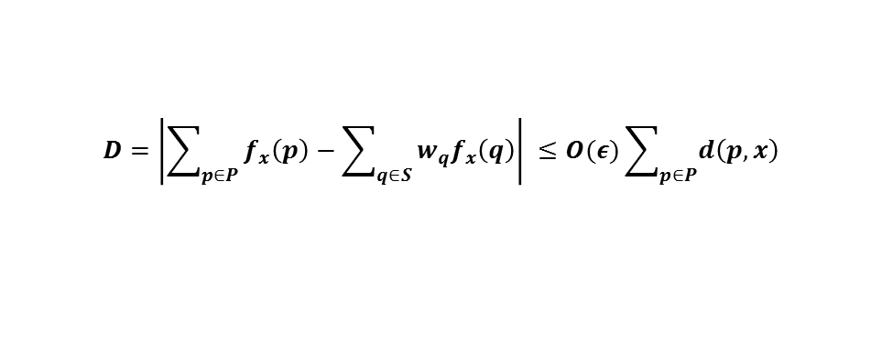
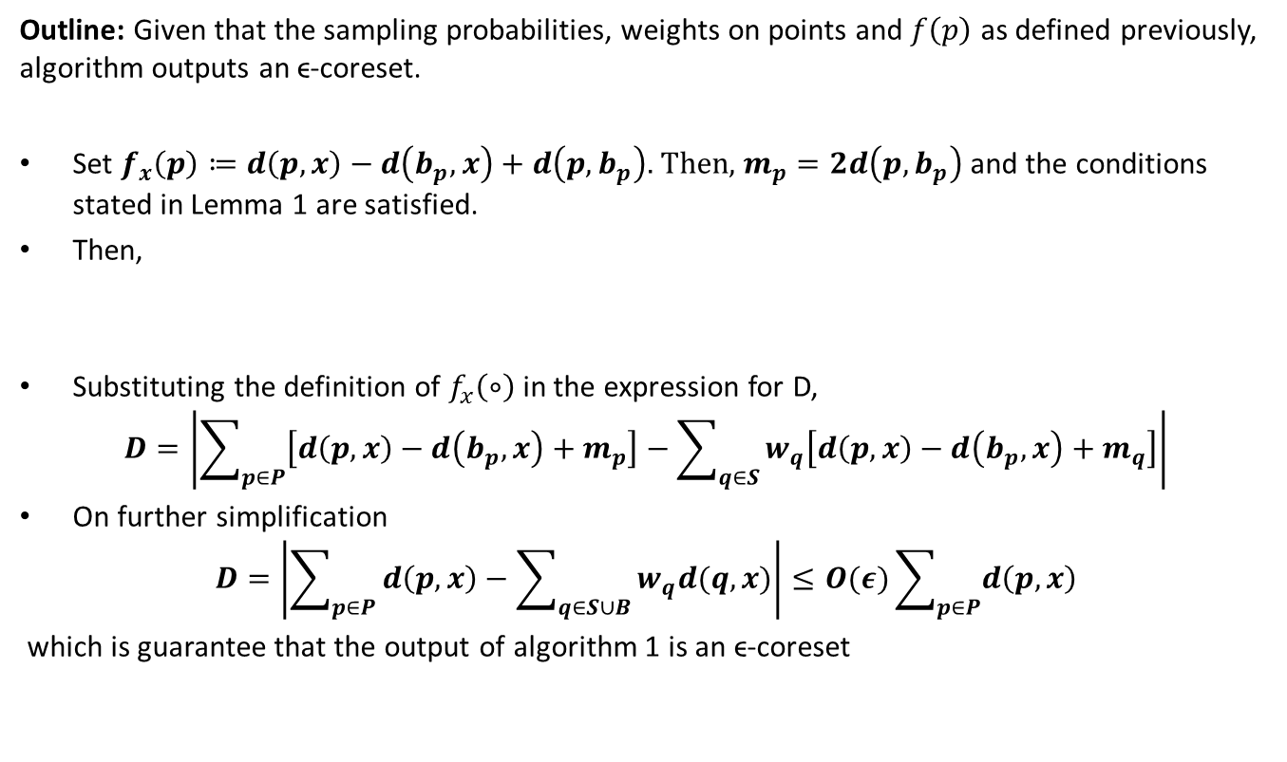
Proof of Theorem 1 for k-medians
Outline: Given that the sampling probabilities, weights on points and $f\left(p\right)$ as defined previously, algorithm outputs an ϵ-coreset.
Set $f_{x}\left(p\right)≔d\left(p,x\right)−d\left(b_{p},x\right)+d\left(p,b_{p}\right).$Then, $m_{p}=2d\left(p,b_{p}\right)$ and the conditions stated in Lemma 1 are satisfied.
Then,
Substituting the definition of $f_{x}\left(∘\right)$in the expression for D,
$$D=\left|\sum_{p∈P}{\left[d\left(p,x\right)−d\left(b_{p},x\right)+m_{p}\right]−\sum_{q∈S}{w_{q}\left[d\left(p,x\right)−d\left(b_{p},x\right)+m_{q}\right]}}\right|$$
On further simplification
$$D=\left|\sum_{p∈P}{d\left(p,x\right)−\sum_{q∈S∪B}{w_{q}d(q,x)}}\right|≤O(ε)\sum_{p∈P}{d\left(p,x\right)}$$
which is guarantee that the output of algorithm 1 is an ϵ-coreset
$$D=\left|\sum_{p∈P}{f_{x}\left(p\right)−\sum_{q∈S}{w_{q}f_{x}\left(q\right)}}\right| ≤O(ε)\sum_{p∈P}{d\left(p,x\right)}$$

Slide 49
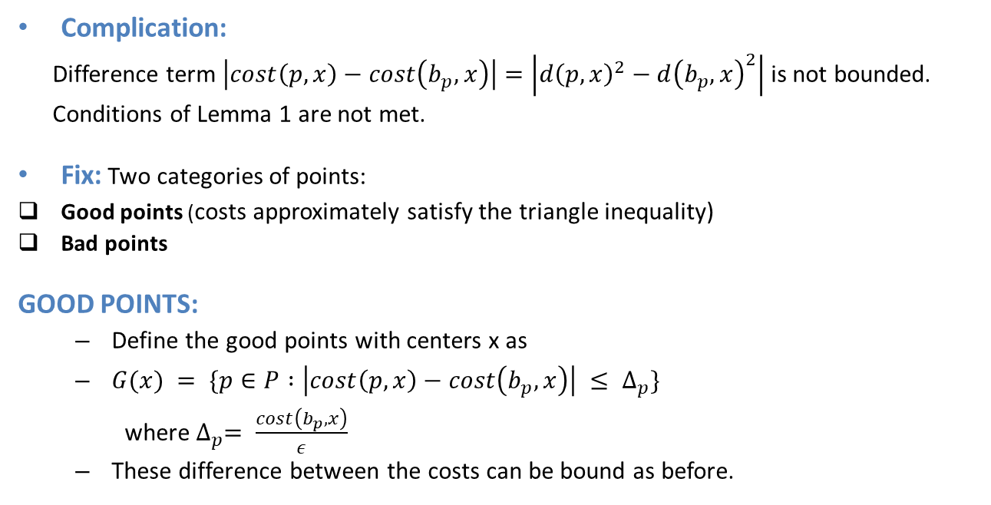
Proof of Theorem 1 for k-means
Complication:
Difference term $\left|cost\left(p,x\right)−cost\left(b_{p},x\right)\right|=\left|{d\left(p,x\right)}^{2}−{d\left(b_{p},x\right)}^{2}\right|$ is not bounded.
Conditions of Lemma 1 are not met.
Fix: Two categories of points:
Good points (costs approximately satisfy the triangle inequality)
Bad points
GOOD POINTS:
Define the good points with centers x as
$G(x) = \{p∈P :\left|cost\left(p,x\right)−cost\left(b_{p},x\right)\right| ≤ Δ_{p}\}$
where${ Δ}_{p}= \frac{cost\left(b_{p},x\right)}{ε}$
These difference between the costs can be bound as before.

Slide 50
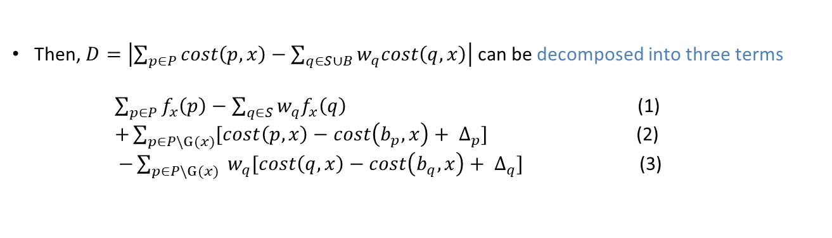
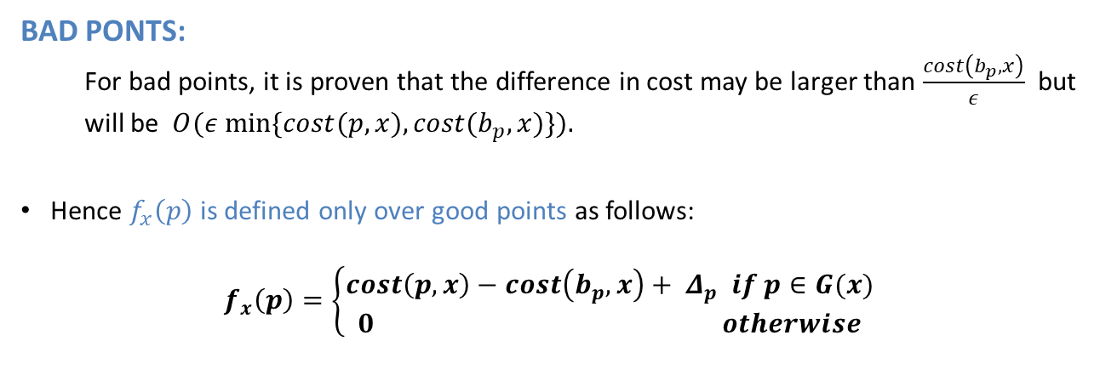
BAD PONTS:
For bad points, it is proven that the difference in cost may be larger than $\frac{cost\left(b_{p},x\right)}{ε}$ but will be $O(ε min⁡\{cost(p, x), cost(b_{p}, x)\}).$
Hence $f_{x}\left(p\right)$ is defined only over good points as follows:
$$f_{x}\left(p\right)=\left\{\begin{aligned}cost\left(p,x\right)−cost\left(b_{p},x\right)+{ Δ}_{p} if p∈G(x) \\ 0 otherwise\end{aligned}\right.$$
Then, $D=\left|\sum_{p∈P}{cost\left(p,x\right)−\sum_{q∈S∪B}{w_{q}cost\left(q,x\right)}}\right|$ can be decomposed into three terms
$\sum_{p∈P}{f_{x}\left(p\right)−\sum_{q∈S}{w_{q}f_{x}\left(q\right)}}$ (1)
$+\sum_{p∈P\backslash G(x)}{[cost\left(p,x\right)−cost\left(b_{p},x\right)+ ∆_{p}]}$ (2)
$−\sum_{p∈P\backslash G(x)}{ w_{q}[cost\left(q,x\right)−cost\left(b_{q},x\right)+ ∆_{q}]}$ (3)

Slide 51
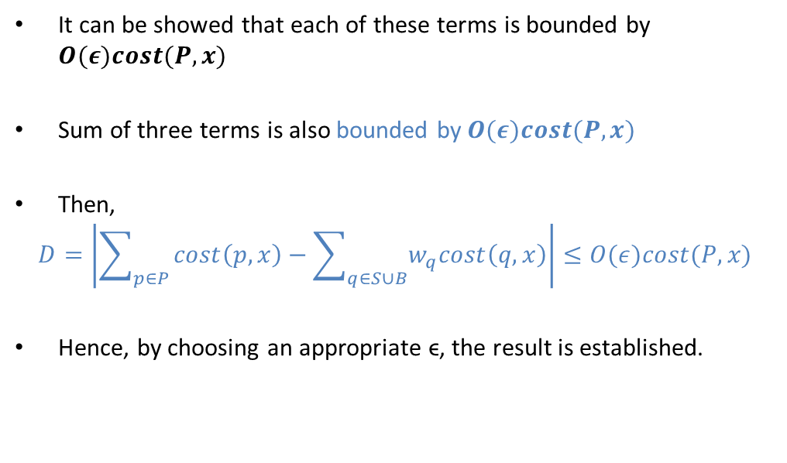
Proof of Theorem 1 for k-means (cont.)
It can be showed that each of these terms is bounded by $O(ε)cost(P, x)$
Sum of three terms is also bounded by $O(ε)cost(P, x)$
Then,
$$D=\left|\sum_{p∈P}{cost\left(p,x\right)−\sum_{q∈S∪B}{w_{q}cost\left(q,x\right)}}\right|≤O(ε)cost(P, x)$$
Hence, by choosing an appropriate ϵ, the result is established.

Slide 52
Pseudo code
Git Link: https://github.com/harshadrai/Distributed_kMeans

Slide 53
Distributed coreset construction
Input: Data (distributed across different nodes)
Compute centers for local data
Compute constant approximation
Communicate costs to nodes
Compute number of points to be sampled
Set weights on local data
Random Sampling of points to coreset
Inclusion of local centers to coreset
Round 1
Round 2
Output: Weighted Coreset

Slide 54
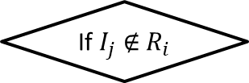


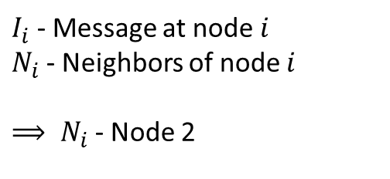


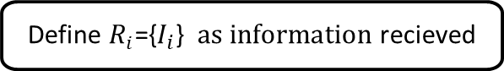


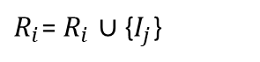
Message Passing
INPUT: Message, Neighbors
Input:
Message to communicate
Neighbors to whom we wish to communicate
the message
Message Passing($I_{i}$, $N_{i}$)
Message Passing($I_{i}$, $N_{i}$)
Define $R_{i}$={$I_{i}$} $as information$recieved
1
Node $i$
Send $I_{i}$ to all neighbors $N_{i}$
2
While $R_{i}≠${$I_{j}:1≤j ≤n$}
3
NO
If $I_{j}$ $∉$ $R_{i}$
$I_{i}$ - Message at node $i$
$N_{i}$ - Neighbors of node $i$
${⟹ N}_{i}$ - Node 2
YES
$R_{i}$= $R_{i}$ $∪${$I_{j}$}
Send $I_{j}$ to all neighbors $N_{j}$

Slide 55
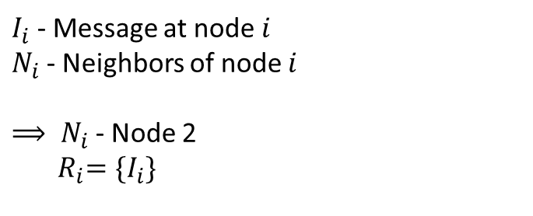
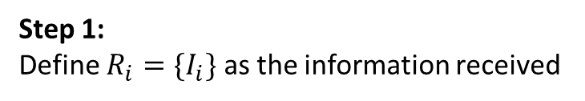
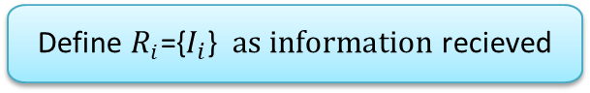

INPUT: Message, Neighbors
Step 1:
Define $R_{i}=\{I_{i}\}$ as the information received
Message Passing($I_{i}$, $N_{i}$)
Message Passing($I_{i}$, $N_{i}$)
Define $R_{i}$={$I_{i}$} $as information$recieved
1
Node $i$ with message $I_{i}$
Send $I_{i}$ to all neighbors $N_{i}$
2
While $R_{i}≠${$I_{j}:1≤j ≤n$}
3
NO
If $I_{j}$ $∉$ $R_{i}$
$I_{i}$ - Message at node $i$
$N_{i}$ - Neighbors of node $i$
${⟹ N}_{i}$ - Node 2
${ R}_{i}=\{I_{i}\}$
YES
$R_{i}$= $R_{i}$ $∪${$I_{j}$}
Send $I_{j}$ to all neighbors $N_{j}$

Slide 56


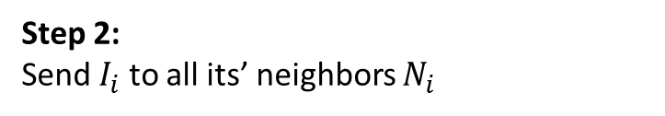
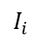

INPUT: Message, Neighbors
Step 2:
Send $I_{i}$ to all its’ neighbors $N_{i}$
Message Passing($I_{i}$, $N_{i}$)
Message Passing($I_{i}$, $N_{i}$)
Define $R_{i}$={$I_{i}$} $as information$recieved
$I_{i}$
Node $i$ with message $I_{i}$
1
Send $I_{i}$ to all neighbors $N_{i}$
2
Message $I_{i}$received
While $R_{i}≠${$I_{j}:1≤j ≤n$}
3
NO
If $I_{j}$ $∉$ $R_{i}$
YES
$R_{i}$= $R_{i}$ $∪${$I_{j}$}
Send $I_{j}$ to all neighbors $N_{j}$

Slide 57
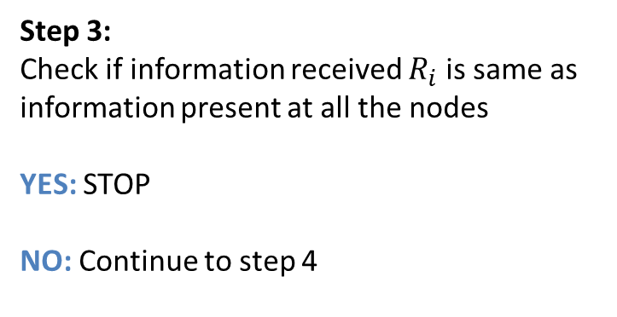

INPUT: Message, Neighbors
Step 3:
Check if information received $R_{i}$ is same as information present at all the nodes
YES: STOP
NO: Continue to step 4
Message Passing($I_{i}$, $N_{i}$)
Message Passing($I_{i}$, $N_{i}$)
Define $R_{i}$={$I_{i}$} $as information$recieved
Send $I_{i}$ to all neighbors $N_{i}$
While $R_{i}≠${$I_{j}:1≤j ≤n$}
NO
If $I_{j}$ $∉$ $R_{i}$
YES
$R_{i}$= $R_{i}$ $∪${$I_{j}$}
Send $I_{j}$ to all neighbors $N_{j}$

Slide 58
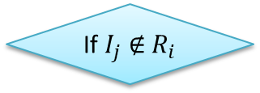
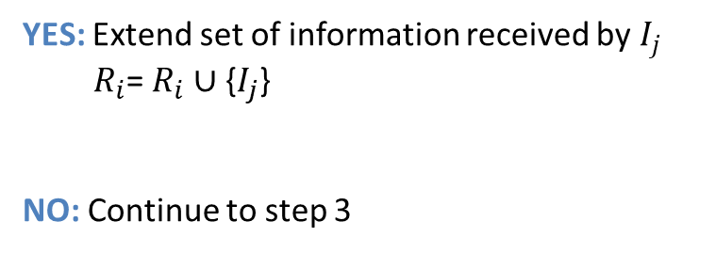

INPUT: Message, Neighbors
Step 4:
Check if information $I_{j}$ $∉$ $R_{i}$
Message Passing($I_{i}$, $N_{i}$)
Message Passing($I_{i}$, $N_{i}$)
YES: Extend set of information received by $I_{j}$
${ R}_{i}$= $R_{i}$ $∪${$I_{j}$}
NO: Continue to step 3
Define $R_{i}$={$I_{i}$} $as information$recieved
Send $I_{i}$ to all neighbors $N_{i}$
While $R_{i}≠${$I_{j}:1≤j ≤n$}
NO
If $I_{j}$ $∉$ $R_{i}$
YES
$R_{i}$= $R_{i}$ $∪${$I_{j}$}
Send $I_{j}$ to all neighbors $N_{j}$

Slide 59
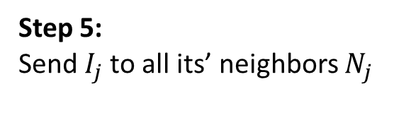

INPUT: Message, Neighbors
Step 5:
Send $I_{j}$to all its’ neighbors $N_{j}$
Message Passing($I_{i}$, $N_{i}$)
Message Passing($I_{i}$, $N_{i}$)
Define $R_{i}$={$I_{i}$} $as information$recieved
Send $I_{i}$ to all neighbors $N_{i}$
While $R_{i}≠${$I_{j}:1≤j ≤n$}
NO
If $I_{j}$ $∉$ $R_{i}$
YES
$R_{i}$= $R_{i}$ $∪${$I_{j}$}
Send $I_{j}$ to all neighbors $N_{j}$

Slide 60

Output:
Communication done among all the nodes
Node $i$
1
2
3
As a result, information is shared globally.
Communication cost at each step = Size of the message

Slide 61
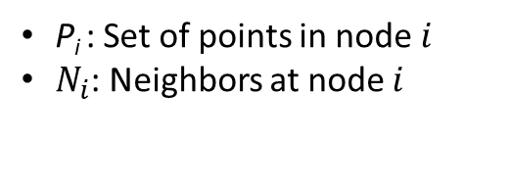
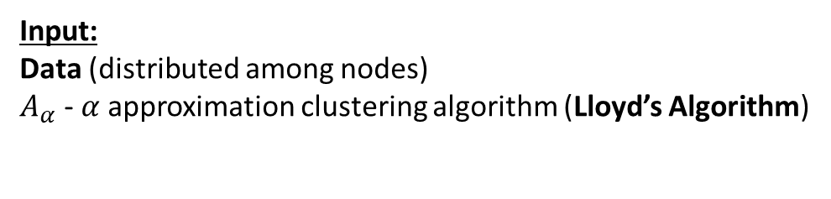
Distributed clustering on graph
Input:
Data (distributed among nodes)
$A_{α}$ - $α$approximation clustering algorithm (Lloyd’s Algorithm)
Get $ε$ local coreset $D_{i}$using Distributed Coreset construction algorithm
Get 𝜀 local coreset 𝐷_𝑖using Distributed Coreset construction algorithm
Call Message_Parsing ( $D_{i}$, $N_{i})$
Call Message_Parsing ( 𝐷_𝑖, 𝑁_𝑖)
X = $A_{α}$ ($∪D_{j})$
X = 𝐴_𝛼 (∪𝐷_𝑗)
Round 1
Round 2
For each node $i$
For each node 𝑖
For each node $i$
For each node 𝑖
P_{i} : Set of points in node$i$
$N_{i}$: Neighbors at node $i$

Slide 62
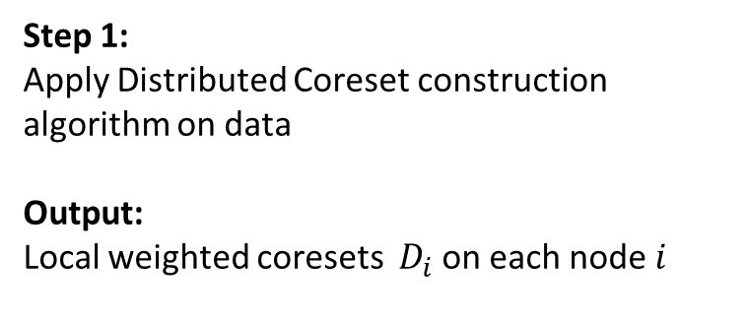
Round 1
Get $ε$ local coreset $D_{i}$using Distributed Coreset construction algorithm
Get 𝜀 local coreset 𝐷_𝑖using Distributed Coreset construction algorithm
Call Message_Parsing ( $D_{i}$, $N_{i})$
Call Message_Parsing ( 𝐷_𝑖, 𝑁_𝑖)
X = $A_{α}$ ($∪D_{j})$
X = 𝐴_𝛼 (∪𝐷_𝑗)
Round 1
Round 2
For each node $i$
For each node 𝑖
For each node $i$
For each node 𝑖
Step 1:
Apply Distributed Coreset construction algorithm on data
Output:
Local weighted coresets $D_{i}$ on each node $i$
Weighted Coresets

Slide 63
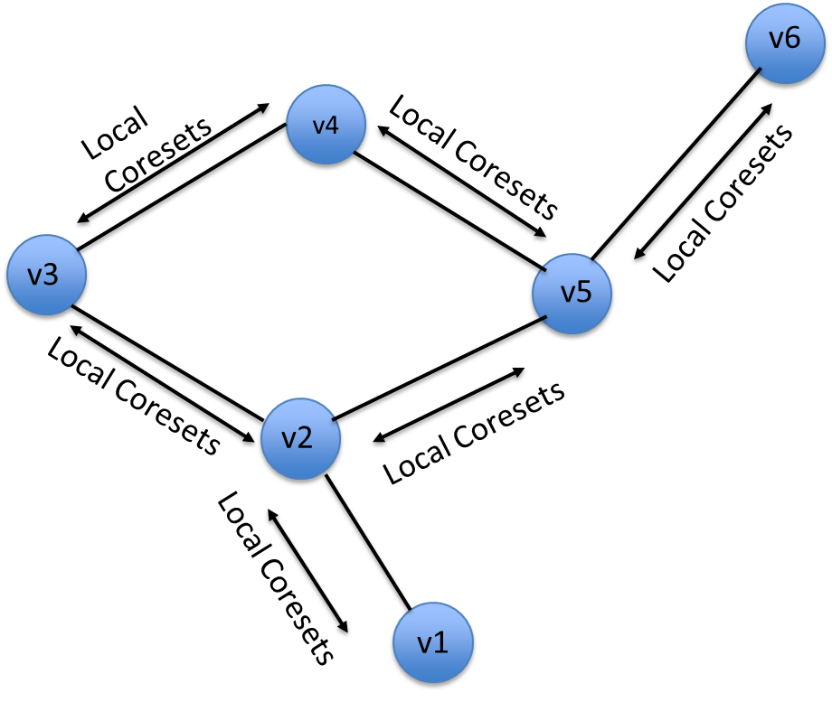
Round 2
Get $ε$ local coreset $D_{i}$using Distributed Coreset construction algorithm
Get 𝜀 local coreset 𝐷_𝑖using Distributed Coreset construction algorithm
Call Message_Parsing ( $D_{i}$, $N_{i})$
Call Message_Parsing ( 𝐷_𝑖, 𝑁_𝑖)
X = $A_{α}$ ($∪D_{j})$
X = 𝐴_𝛼 (∪𝐷_𝑗)
Round 1
Round 2
For each node $i$
For each node 𝑖
For each node $i$
For each node 𝑖
Step 1:
Distributed coresets are communicated to each node
Using Message Passing algorithm

Slide 64
Round 2
Get $ε$ local coreset $D_{i}$using Distributed Coreset construction algorithm
Get 𝜀 local coreset 𝐷_𝑖using Distributed Coreset construction algorithm
Call Message_Parsing ( $D_{i}$, $N_{i})$
Call Message_Parsing ( 𝐷_𝑖, 𝑁_𝑖)
X = $A_{α}$ ($∪D_{j})$
X = 𝐴_𝛼 (∪𝐷_𝑗)
Round 1
Round 2
For each node $i$
For each node 𝑖
For each node $i$
For each node 𝑖
Step 2:
Lloyd’s clustering algorithm is applied to compute the centers for the global dataset
Output:
Centers of the Global dataset

Slide 65
Random Graph
Each edge is generated independently with probability p.
For experiments, we used p = 0.3 and 10 nodes.
Preferential Graph
Preferential graphs are generated using the preferential attachment process.
Additional edges are added continuously to the graph that are distributed among the nodes as an increasing function of the number of edges the nodes already have.

Slide 66
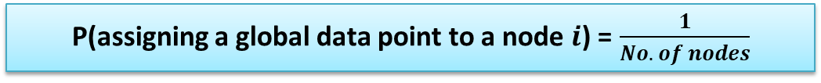
Uniform Partitioning
Each data point from global dataset is assigned to a local site with equal probability.
Randomly Sample $\frac{|Global Set|}{\#Nodes}$ points
Randomly Sample (|𝐺𝑙𝑜𝑏𝑎𝑙 𝑆𝑒𝑡|)/(#𝑁𝑜𝑑𝑒𝑠) points
Assign sample to node $i$
Assign sample to node 𝑖
Uniform Partitioning
For each node $i$
For each node 𝑖
P(assigning a global data point to a node $i$) = $\frac{1}{No. of nodes}$

Slide 67
Weighted Partitioning
Each data point from global dataset is assigned to a local site with probability proportional to the nodes’ weight.
Assign a weight $w_{i}$ chosen by |N(0,1)|
Assign a weight 𝑤_𝑖 chosen by |N(0,1)|
Assign sample to node $i$
Assign sample to node 𝑖
Weighted Partitioning
For each node $i$
For each node 𝑖
Randomly Sample $w_{i}\left|Global Set\right|$points
Randomly Sample 𝑤_𝑖 |𝐺𝑙𝑜𝑏𝑎𝑙 𝑆𝑒𝑡| points
P(assigning a global data point to a local site $i$) =${ w}_{i}$

Slide 68
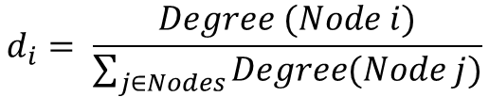
Degree Partitioning
Each data point from global dataset is assigned to a local site with probability proportional to the nodes’ degree.
Compute the normalized degree $d_{i}$
Compute the normalized degree 𝑑_𝑖
Assign sample to node $i$
Assign sample to node 𝑖
Degree Partitioning
For each node $i$
For each node 𝑖
Randomly Sample $d_{i}\left|Global Set\right|$points
Randomly Sample 𝑑_𝑖 |𝐺𝑙𝑜𝑏𝑎𝑙 𝑆𝑒𝑡| points
$$d_{i}= \frac{Degree (Node i)}{\sum_{j∈Nodes}{Degree(Node j)}}$$
P(assigning a global data point to a local site $i$) = $d_{i}$

Slide 69
Results

Slide 70
Inferences
•For all the datasets k-means cost ratio was plotted against communication cost.
•k-means cost ratio is defined as the ratio obtained by running Lloyd’s algorithm on the coreset and the global data respectively to get two solutions, and computing the ratio between the costs of the two solutions over the global data.
•For all the datasets the k-means cost ratio reduced when communication cost increases. This implies that when larger coresets are generated the solution of the proposed algorithm converges to the k-means solution.
•Same results were obtained on Random and Preferential graph with three types of partitioning namely, uniform partitioning, weighted partitioning and degree partitioning.
•Results were also consistent on different dataset.

Slide 71
Datasets Used
Following 4 datasets were used
Corel Image Features: This dataset contains image features extracted from a Corel There are total 68040 observations.
2) Spambase Data Set: There are total 4601 observations with 58 dimensions. There were 1813 marked as spam and 2788 marked as non-spam.
3) Letter Recognition Dataset: The dataset was made to identify each of a large number of black-and-white rectangular pixel displays as one of the 26 capital letters in the English alphabet. There are total of 20000 observations each observation has 16 attributes.
4) SFpark dataset: The dataset contains data from three hundred parking lots in San Francisco city fitted with Smart Meters. In the processed data the rows represents Parking lots and columns represents time. There were total 300 rows (one for each parking lot) and 2880 columns (24 hours x 15 time slots x 30 days).

Slide 72
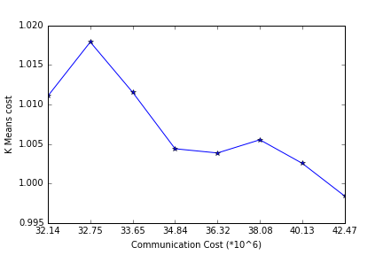
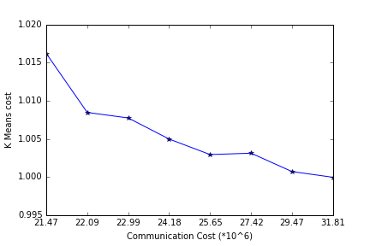
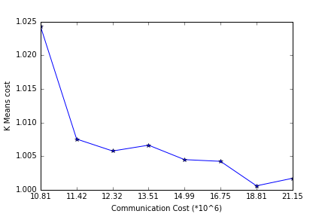
LETTER DATASET
Random Graph
Degree Partitioning
Random Graph
Weighted Partitioning
Random Graph
Uniform Partitioning

Slide 73



LETTER DATASET
Preferential Graph
Weighted Partitioning
Preferential Graph
Uniform Partitioning
Preferential Graph
Degree Partitioning

Slide 74



SPAM DATASET
Preferential Graph
Degree Partitioning
Preferential Graph
Weighted Partitioning
Preferential Graph
Uniform Partitioning

Slide 75



COLOR HISTOGRAM DATASET
Preferential Graph
Degree Partitioning
Preferential Graph
Weighted Partitioning
Random Graph
Degree Partitioning

Slide 76



TRAFFIC DATASET
Random Graph
Weighted Partitioning
Random Graph
Uniform Partitioning
Preferential Graph
Uniform Partitioning

Slide 77

Summary
Datasets are getting larger in size, so they are being stored on distributed systems. Increasing the efficiency of the algorithm which work on such distributed systems has gained importance.
Based on the algorithm proposed in the paper a python code was written to perform distributed k-means clustering.
4 different datasets from two different sources was used to evaluate the performance of the algorithm.
The k-means cost ratio reduces with increase in communication cost.
We were able to replicate results given in the paper.
Applications and connections to course
Comparison between two graphs
(Letter Random Weighted)

Slide 78
References:
[1] Q. Zhang, J. Liu, and W. Wang. Approximate clustering on distributed data streams. In Proceedings of the IEEE International Conference on Data Engineering, 2008.
[2] D. Feldman, A. Sugaya, and D. Rus. An effective coreset compression algorithm for large scale sensor networks. In Proceedings of the International Conference on Information Processing in Sensor Networks, 2012.
[3] K. Bache and M. Lichman. UCI machine learning repository, 2013.
[4] S.R.Boselin Prabhu, S.Sophia, S.Maheswaran, M.Navaneethakrishnan. Real-World Applications of Distributed Clustering Mechanism in Dense Wireless Sensor Networks, 2013.
[5] C. Olston, J. Jiang, and J. Widom. Adaptive filters for continuous queries over distributed data streams. In Proceedings of the ACM SIGMOD International Conference on Management of Data, 2003.

Slide 79
THE END

Slide 80


Slide 81

The objective is to identify each of a large number of black-and-white rectangular pixel displays as one of the 26 capital letters in the English alphabet. The character images were based on 20 different fonts and each letter within these 20 fonts was randomly distorted to produce a file of 20,000 unique stimuli. Each stimulus was converted into 16 primitive numerical attributes (statistical moments and edge counts) which were then scaled to fit into a range of integer values from 0 through 15. We typically train on the first 16000 items and then use the resulting model to predict the letter category for the remaining 4000. See the article cited above for more details.

Slide 82

EXTRA

Slide 83

SF Parking Data

Slide 84




Slide 85


Definitions
Definition 1:(ϵ-Coreset )
An ϵ-coreset for a set of points P with respect to a center-based cost function is a set of points S and a set of weights w:S→R such that for any set of centers X,
Definition 2: ( Dimension of the function space)
Let F be a finite set of functions from a set P to R₀. Then for f ϵ F, define the set B(f, r) ={ p: f(p) ≤ r}. Then the dimension of the function space D(F, P) is the smallest integer d such that for any G $⊆$ P,

